Slide 1

NC Census Employment Data analysis
Project Team:
Eunjeong Lee, Bill Pezzullo, Abby Pearson, Teshanee Williams, Niral Patel

Slide 2
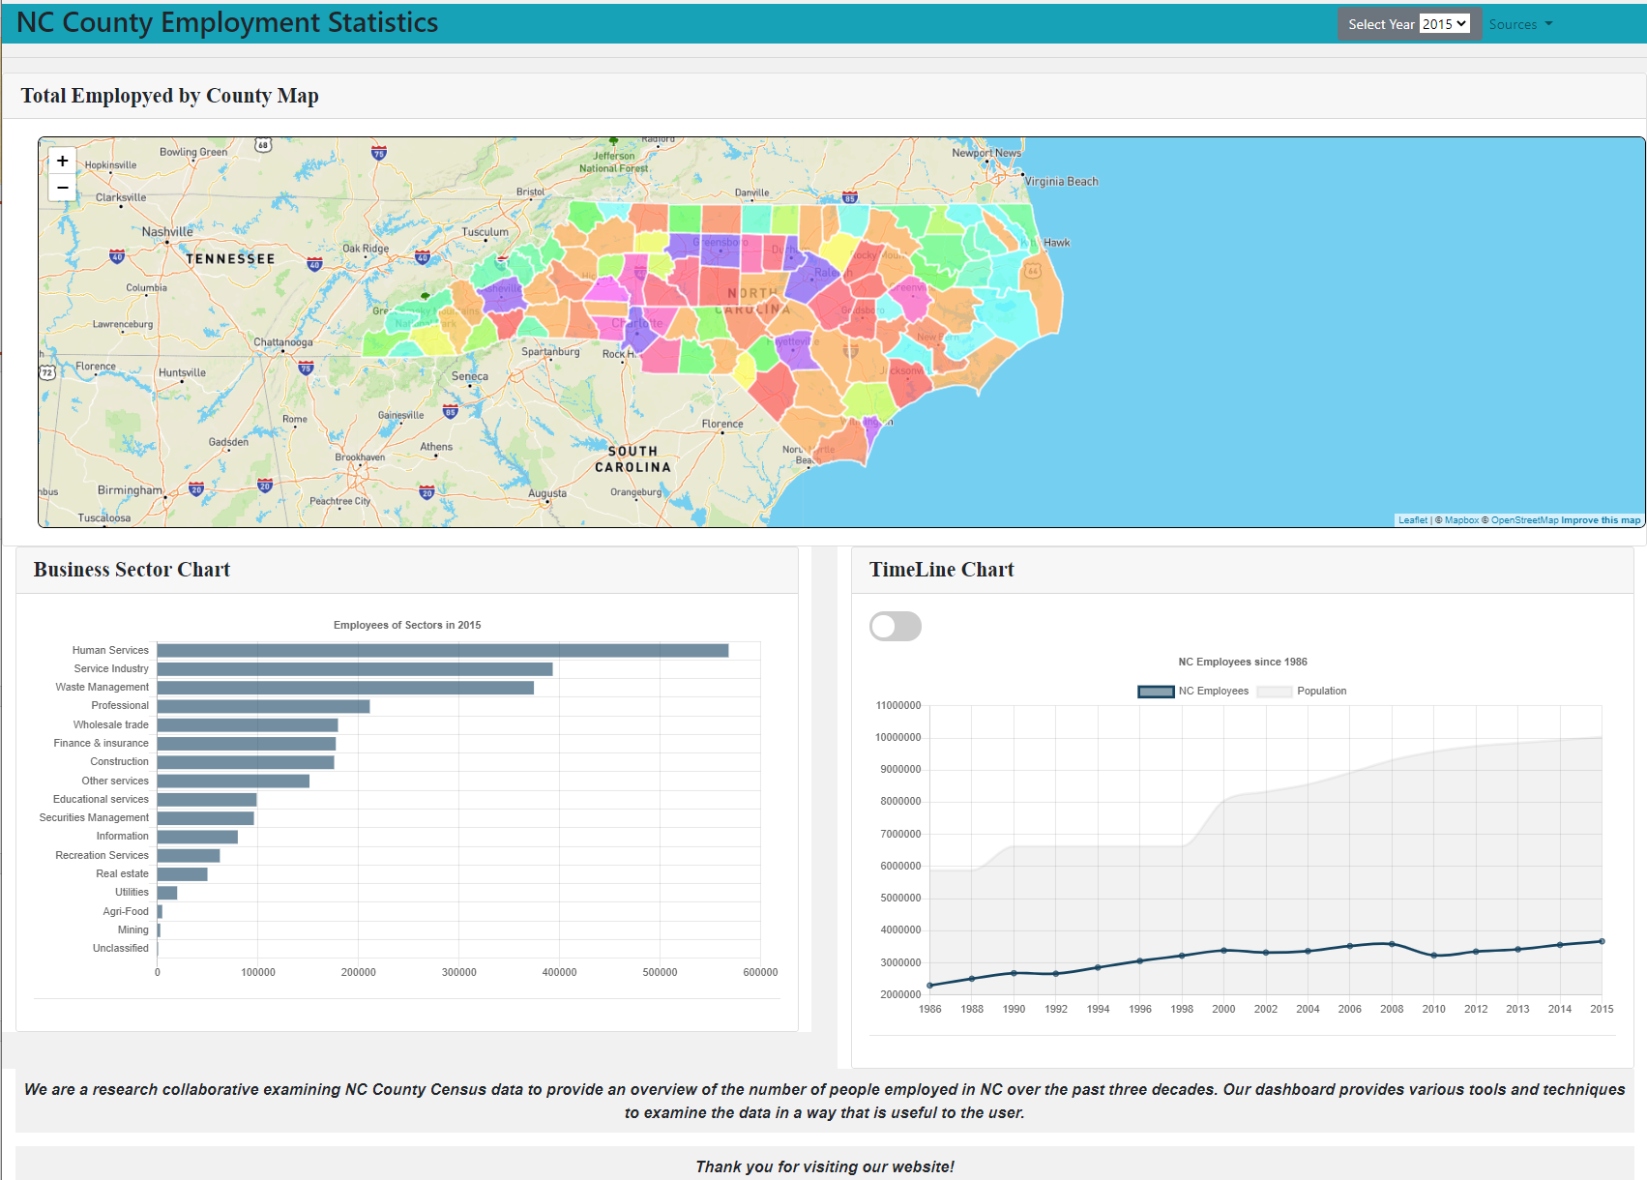
Product Introduction
Show the working site
Explain all features on the site
Data visualization information

Slide 3
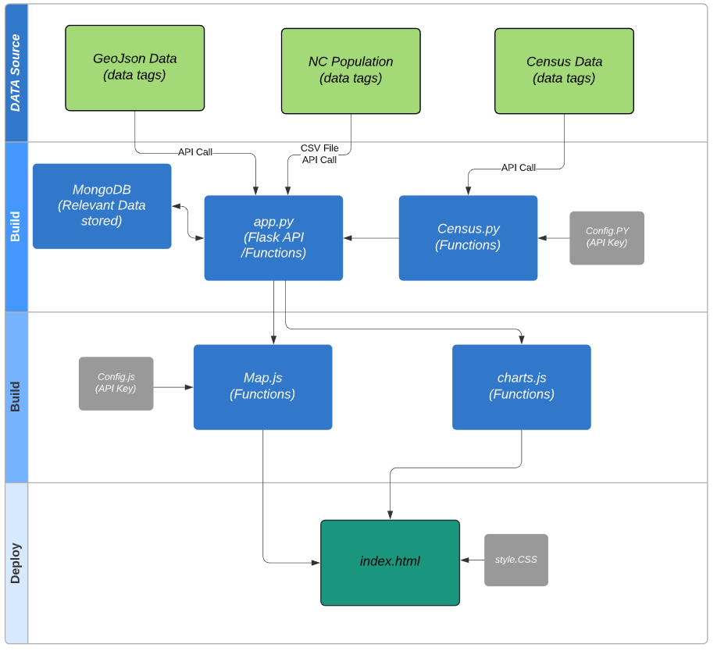
High Level Data Flow
Database:
MongoDB
Front-End Technology:
Chart.js
Mapbox
D3
Leaflet
Flasks
HTML
Bootstrap
Notes:
Three main phase
Data sources
Build (Python, Java & HTML)
Deploy

Slide 4
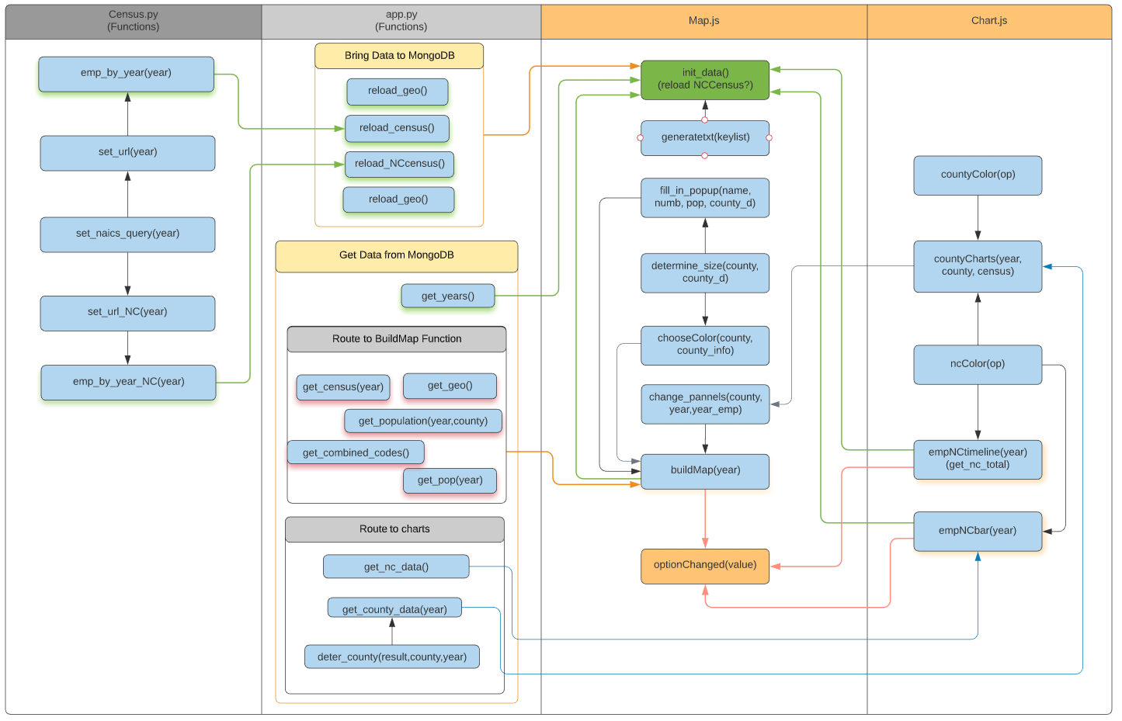
Function Flow Diagram

Slide 5
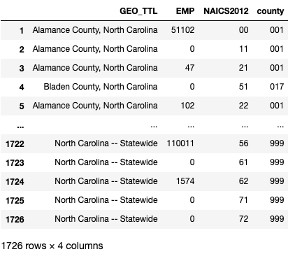
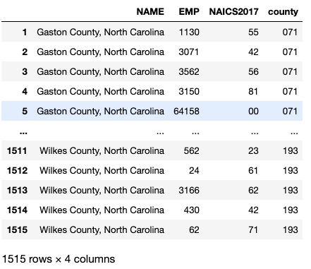
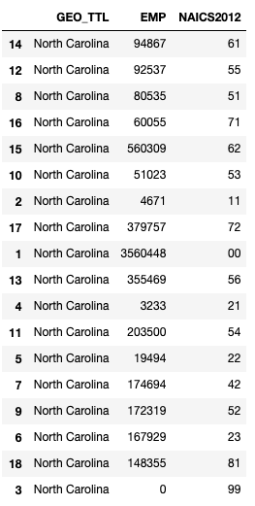
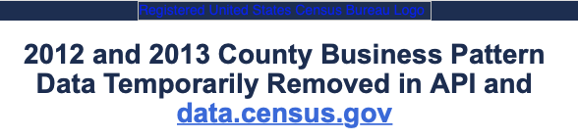
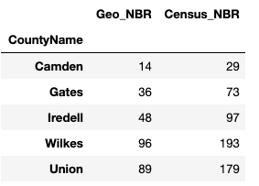
Data Collection
MongoDB: censusdb
Collection: census
1986 | 1988 | 1990 | 1992 | 1994 | 1996 | 1998 | 2000 | 2002 | 2004 | 2006 | 2008 | 2010 | 2012 | 2013 | 2014 | 2015 | 2016 | 2017 | 2018
CBP: Total EMP
Query variables for API call:
GEO_TTL, EMP
CBP: Total EMP
NAICS1997_TTL,
GEO_TTL,
EMP
CBP: Total EMP
NAICS2002_TTL,
GEO_TTL,EMP
CBP: Total EMP
NAICS2007_TTL,
GEO_TTL,
EMP
County Business Patterns(CBP):
Business Sectors
GEO_TTL,
EMP
CBP: Business Sectors
NAME,
EMP
MongoDB: censusdb
Collection: nccensus
County Codes(Number) – json file
CBP: State-wide EMP
CBP: State-wide EMP
CBP: State-wide EMP
CBP: State-wide EMP
CBP:
State-wide Business Sectors EMP
CBP: State-wide Business Sectors EMP
CSV file
Population: 1980, 1990, 2000 census results
Source: NC census demographic data
Population: 2001~ 2009
Source: Population Estimate Program of Census.gov
Population: Annual County Population
Source: NC OSBM demographic table
Notes:
We collected NC employment data from census dot gov through api calls for these years.
But, 2 days ago, I got an email of this. The api calls of two years do not work right now, so we had to delete 2012 and 2013 from our page.
The data provide the number of employees of each business sector for each county.
[click] Each year data has about 1500 rows.
Some tables have statewide employee data. But, the existing data is incorrect. For example, when sector number is 61 it says zero which is odd. The data requested for only statewide gives correct numbers.
[click]
So we perform api calls separately for statewide data.
[click][click]
The query variables have changed over the years.
We had to deal with the different indices in data cleaning process.
[click] [click] [click]
To see the employment rate, we also collected population data.
Since the sources are different, we had to match the county names and the data format.
[click]
The county employee data was loaded into mongo db, census collection.
[click]
State-wide data was loaded into nccensus collection.
[click] The combined population table was stored in csv file. (Each year 100 rows)
The map geojson has county number which is different from census data. We made combined table and stored in json file.
Teshanee will summarize our presentation after giving you interesting observations.

Slide 6
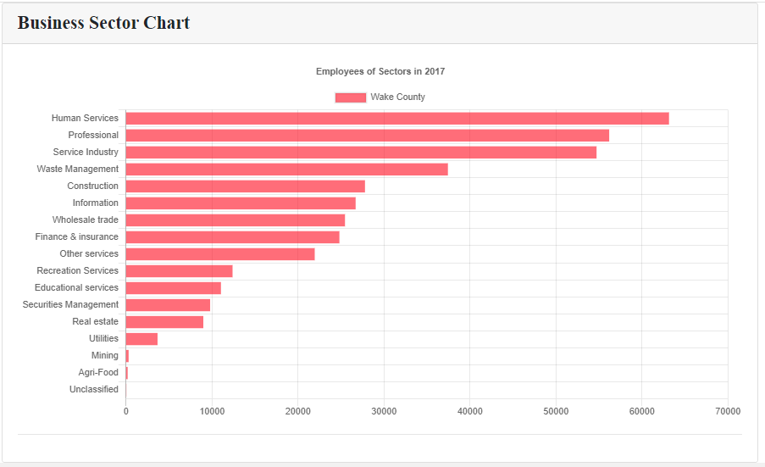
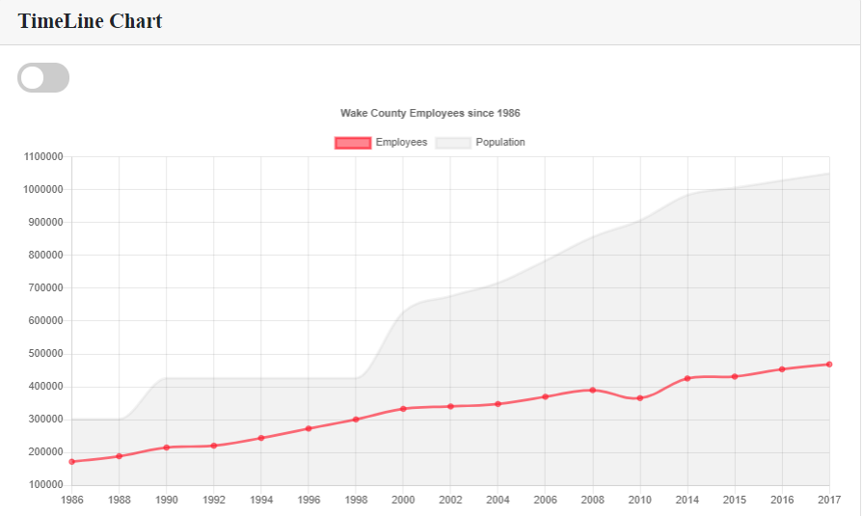
Summary
NC county Census employment data analysis for multiple years.
This dashboard provides an overview of the population and employment data for the year selected. The map allows you to select the county of interest which then displays more data for each county.
Users have the option to drill down into the data per county
The timeline chart stacks employment data against county population to provide a visualization of population growth vs. employment.
The business sector chart shows employment industries from top down.
Notes:
In summary the purpose of our project was to examine NC County Census data to provide an overview of the number of people employed in NC over the past three decades.
The dashboard allows users to drill down and examine the population and employment data for the year selected by county – which you can see in the time line chart.
The Busines sector chart allows users to examine employment fluctuations by industry in each county.
One of the most interesting findings was BLAH
We presume that this was due to BLAH

Slide 7
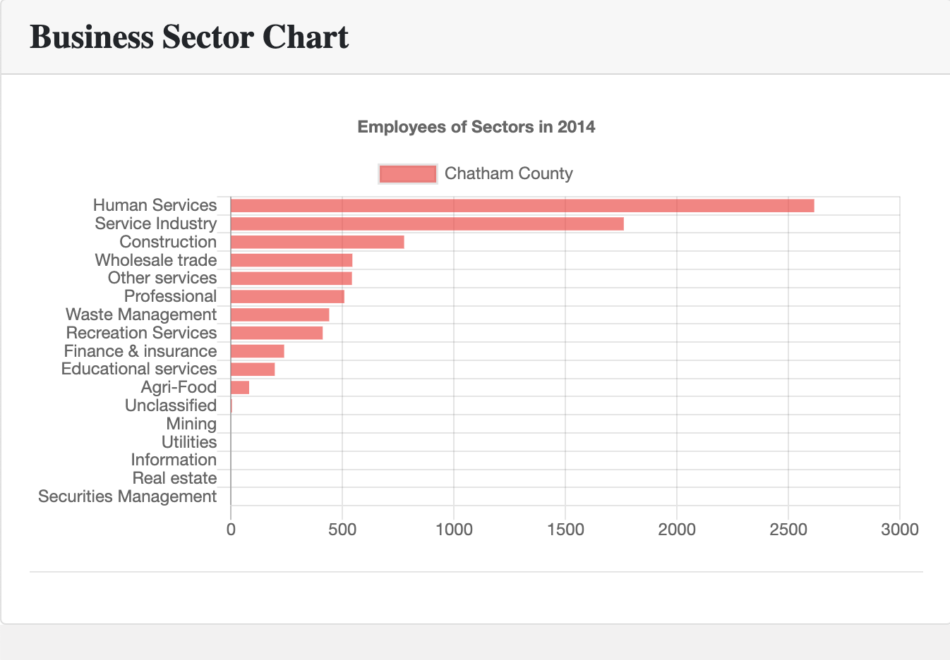
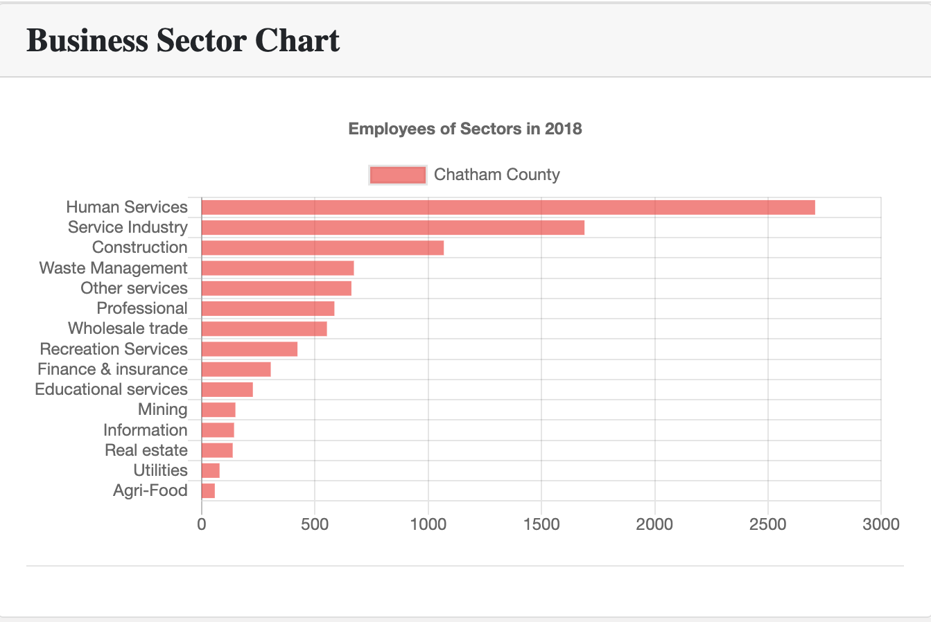
Summary
Chatham County
2014
Chatham County
2018
Notes:
In summary the purpose of our project was to examine NC County Census data to provide an overview of the number of people employed in NC over the past three decades.
The dashboard allows users to drill down and examine the population and employment data for the year selected by county – which you can see in the time line chart.
The Busines sector chart allows users to examine employment fluctuations by industry in each county.
One of the most interesting findings was BLAH
We presume that this was due to BLAH

Slide 8
Question?

Slide 9
APP Routes
Loading data to MongoDB (Initialize)
/reload_geo
/reload_census
/reload_nccensus
Get Map, County codes data
/get_geo", methods=["GET"])
/get_combined_codes
Get EMP data
/get_census/<year>"
/get_county_data/<county>
/get_nc_data/<year>
/get_nc_total/<year>
Get Population data
/get_population/<year>/<county>
/get_pop/<year>

Slide 10
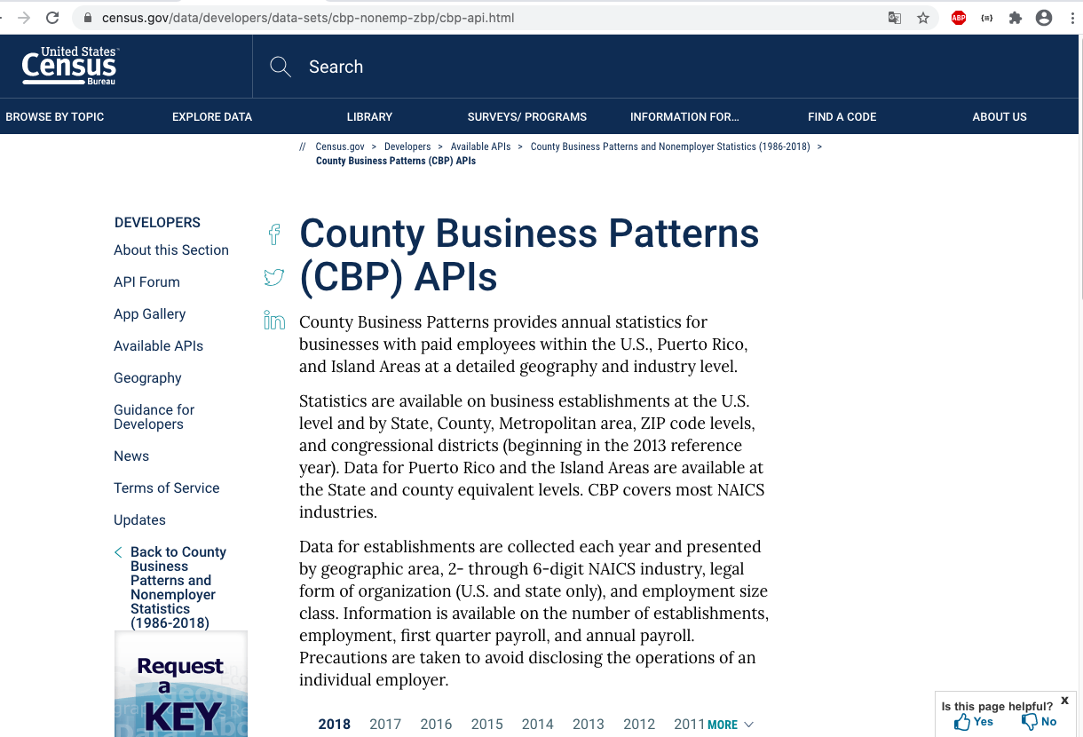
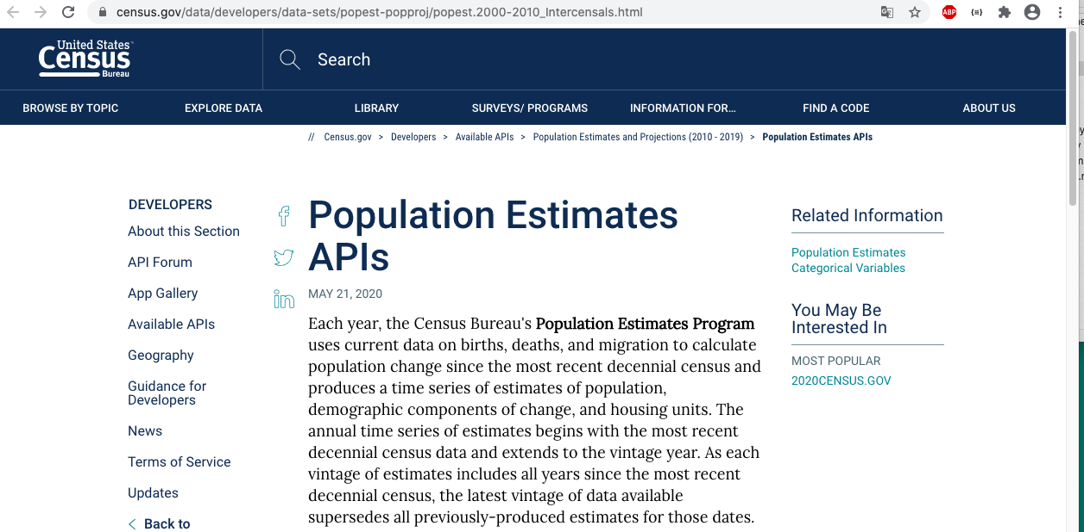
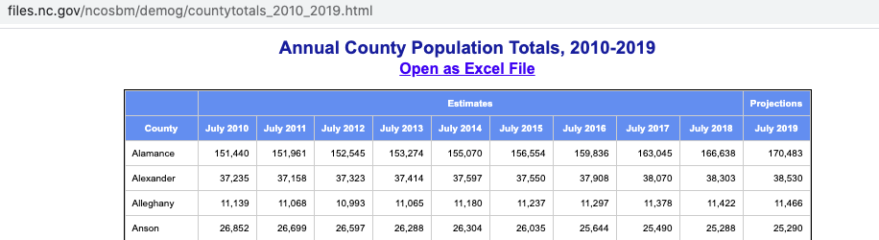

Slide 11
